Slide 1

Group 2 - Project 1
Working with SQL Databases
by
Yevgeniy Sumaryev, Muhammad Ali Sajjad, Andy Qu, Sital Pun, Jean Gomez, Chao Wang

Slide 2
Project Agenda
Finalize Project Plan
Our aim was to figure out an adequate project plan in order to separate our tasks and meet deadlines.
PowerPoint
JBDC
Best & worst queries
After our queries were completed, we aimed to construct our JBDC to run the top queries and complete a PPT to showcase our work
10/07
10/11
9/30
10/10
Complete our individual 20 Queries
We each completed our own individual queries and created each of our separate PDF and SQL files
Submit our project before deadline
We then completed our voice annotation of both the PPT and JBDC. Correct the queries we rank the lowest

Slide 3
Attendance Tracking
 | Meeting-1 9/25 | Meeting-2 10/1 | Meeting-3 10/5 | Meeting-4 10/8 | Meeting-5 10/10
Yevgeniy | ✔️ | ✔️ | ✔️ | ✔️ | ✔️
Muhammad | ✔️ | ✔️ | ❌ | ✔️ | ✔️
Andy | ✔️ | ❌ | ✔️ | ✔️ | ✔️
Sital | ✔️ | ✔️ | ✔️ | ❌ | ✔️
Jean | ✔️ | ❌ | ✔️ | ✔️ | ✔️
Chao | ✔️ | ✔️ | ✔️ | ❌ | ✔️

Slide 4
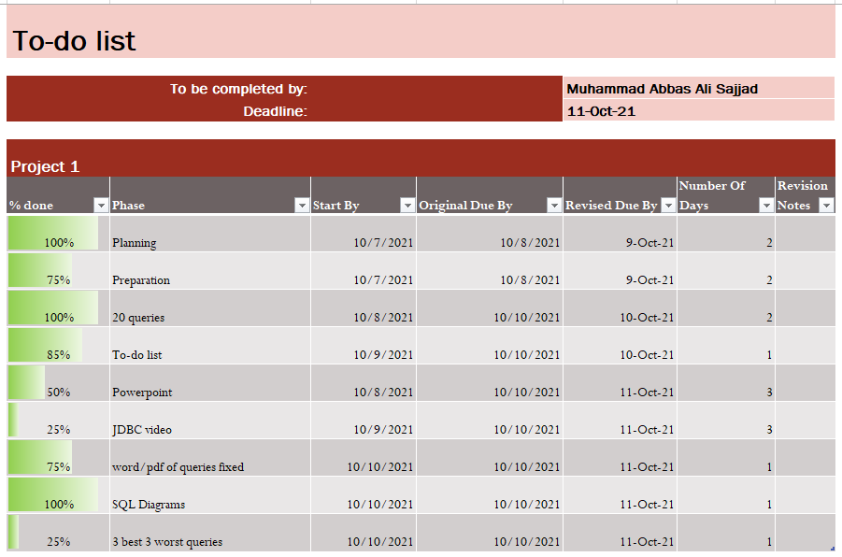
Using To-Do List

Slide 5
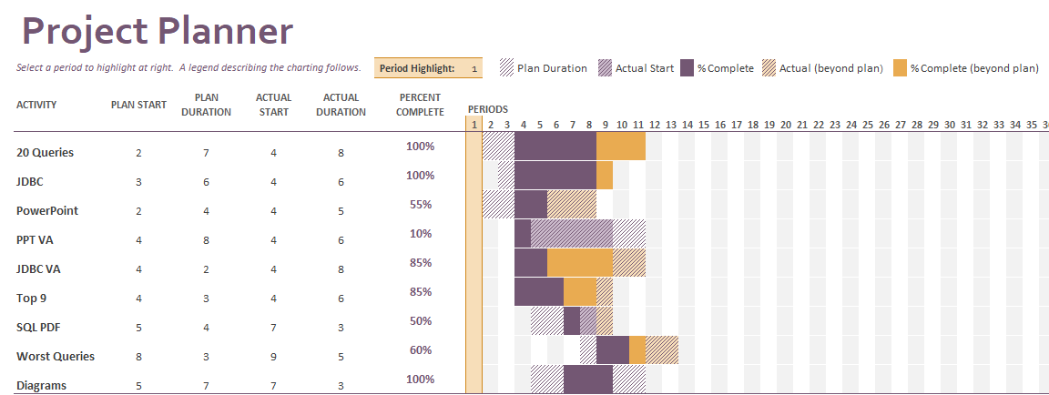
Using the Project Planner

Slide 6
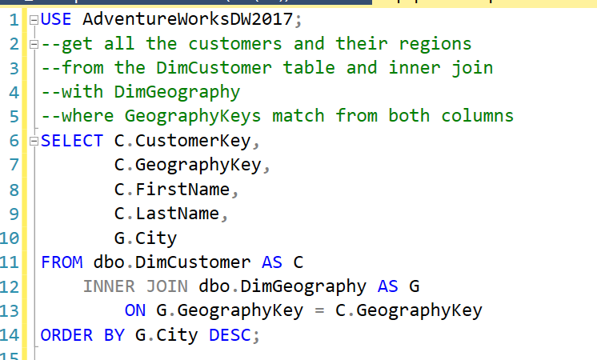
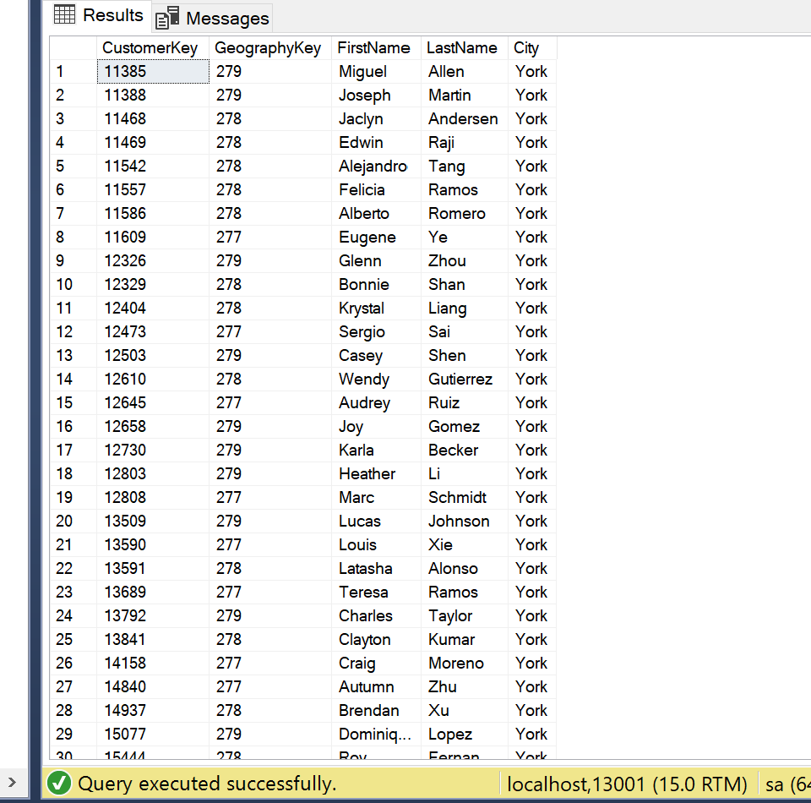
Yevgeniy

Slide 7
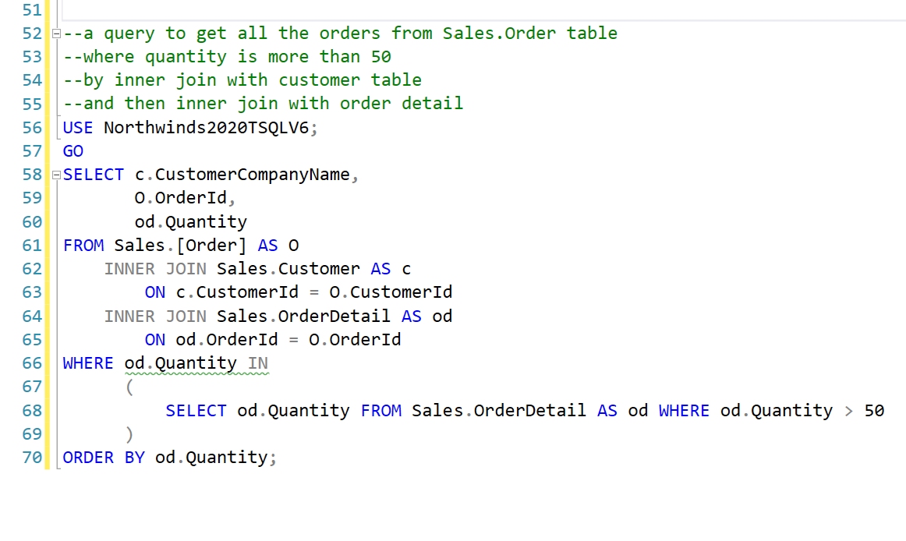
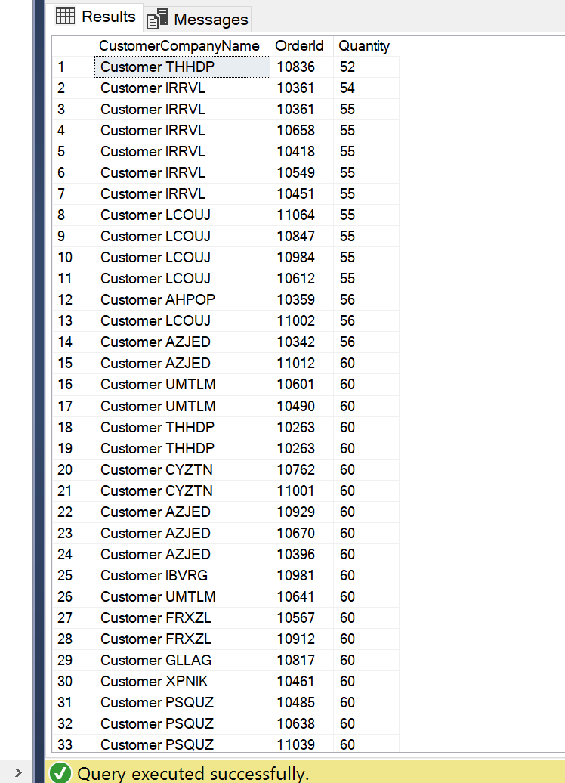
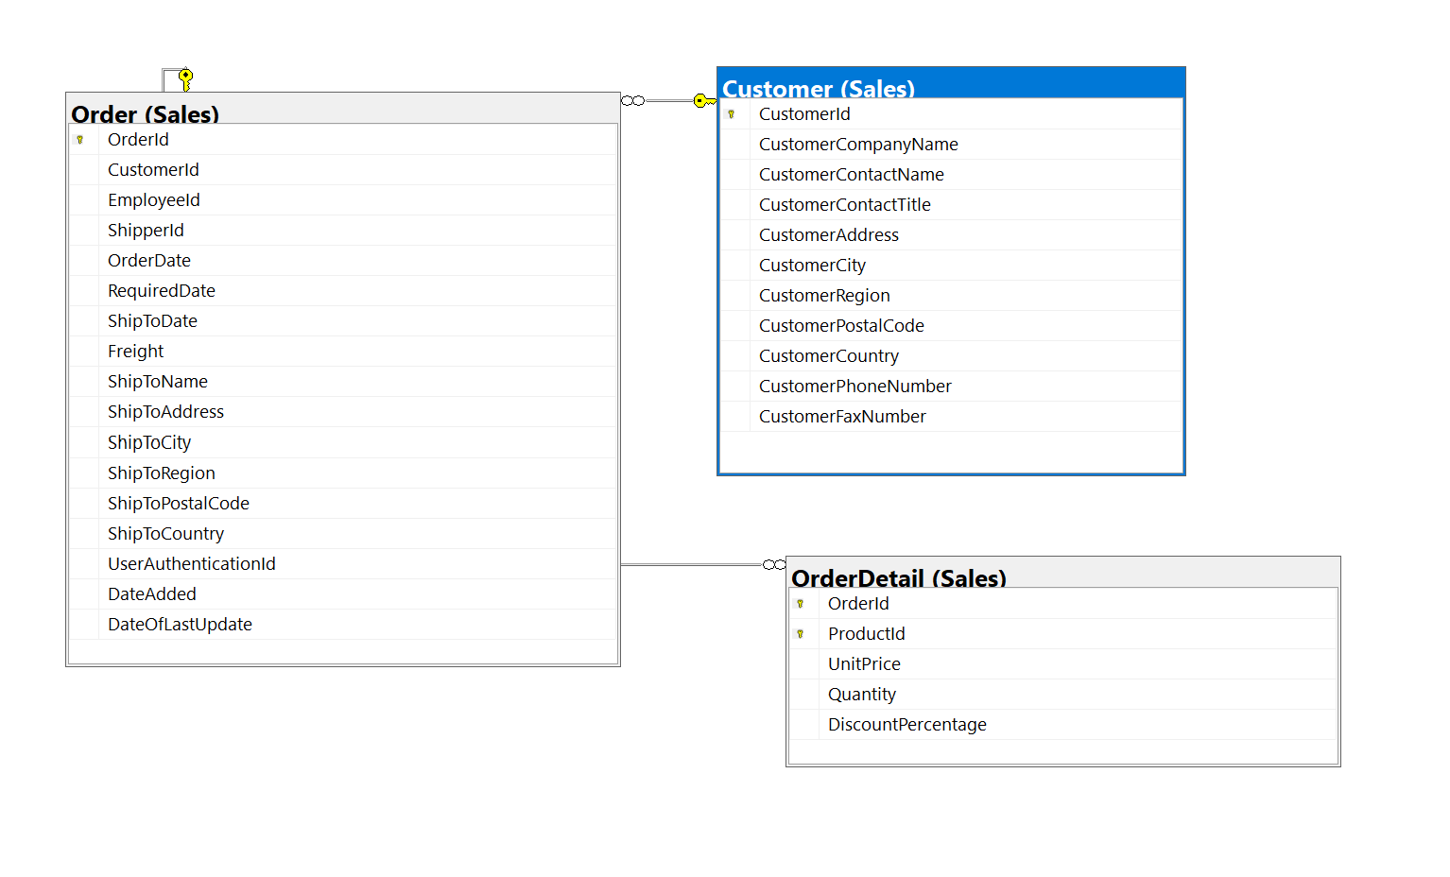
Second query

Slide 8
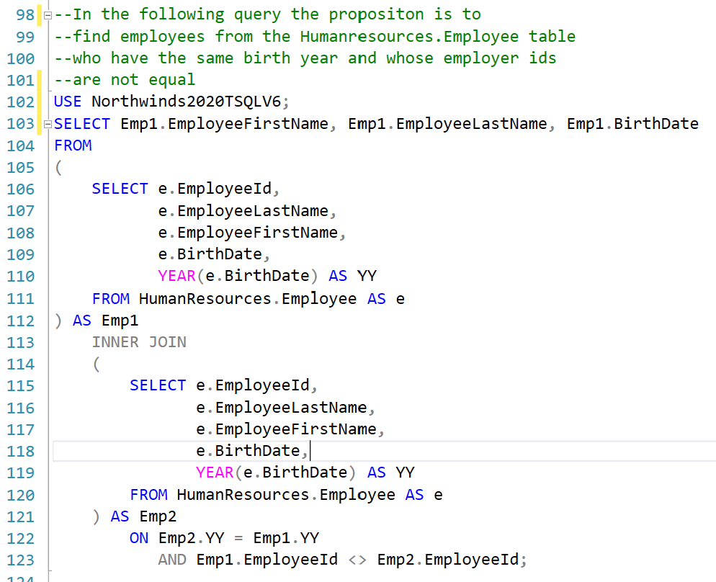
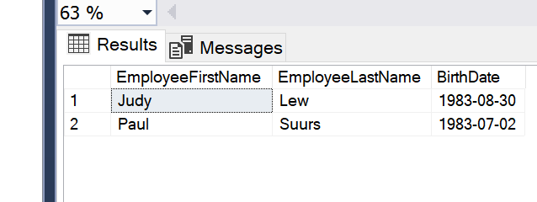
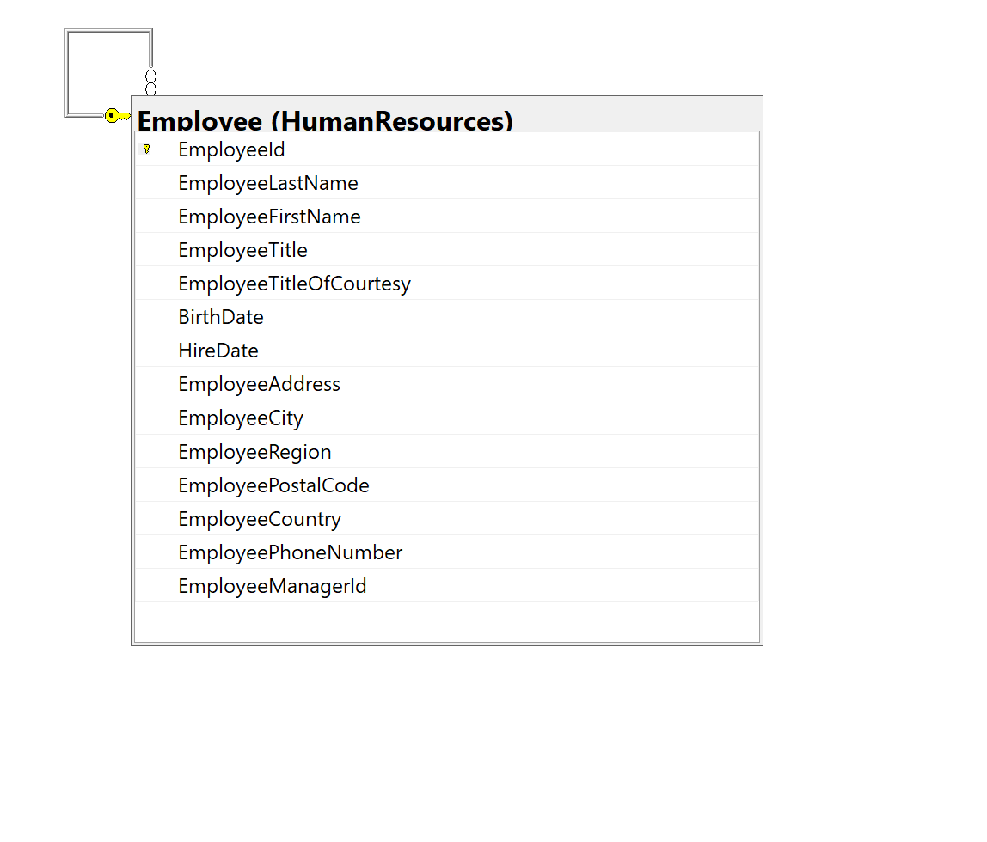

Slide 9
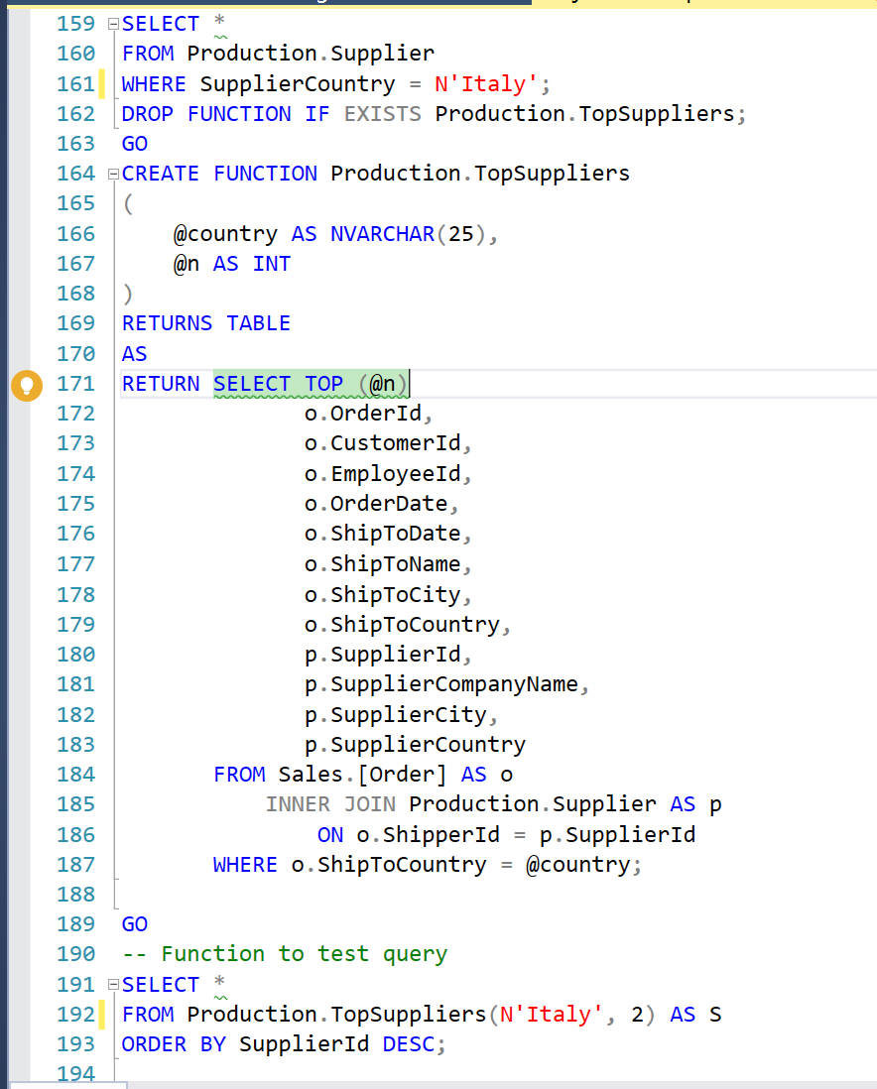
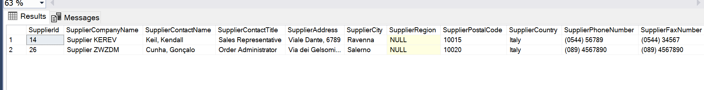
Adds top N suppliers from Italy
Uses Northwinds DB

Slide 10
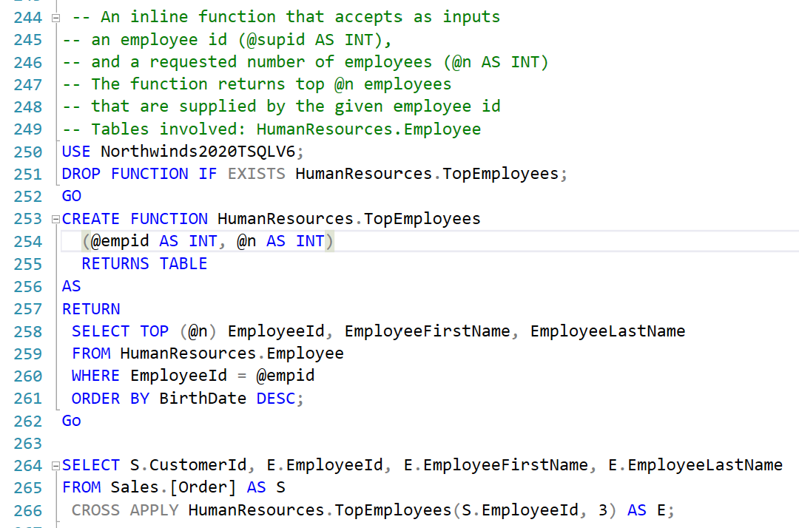
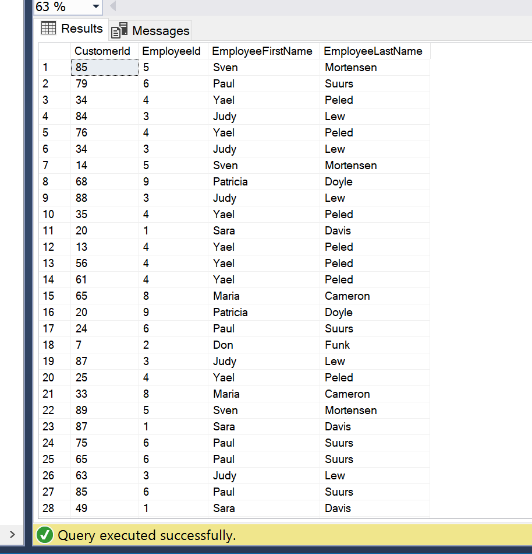
Function returns duplicates. Needs to check if empl is same

Slide 11
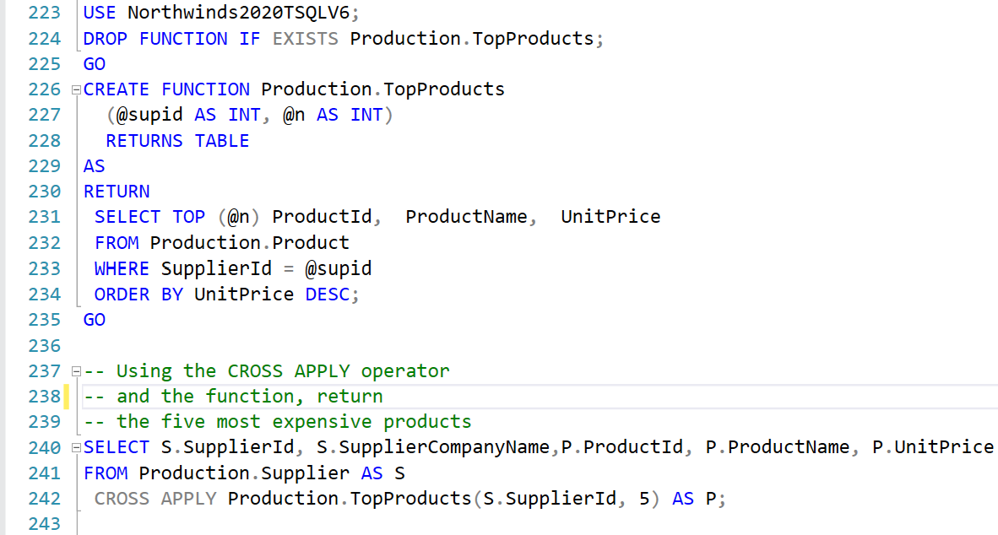
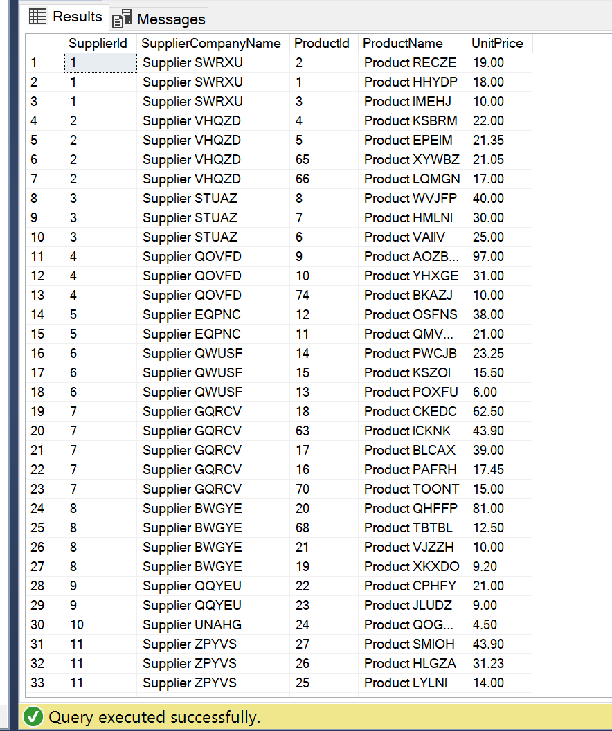
Using function to return Top N products from
Every supplier

Slide 12
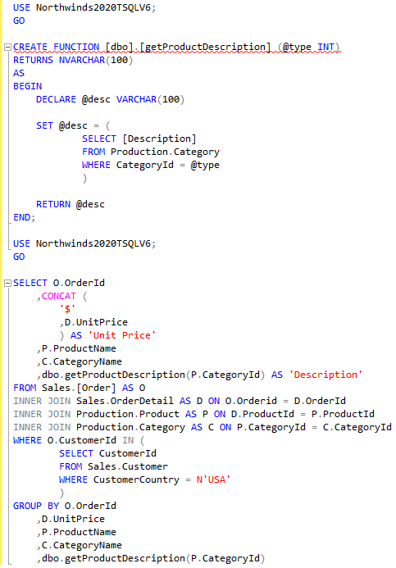
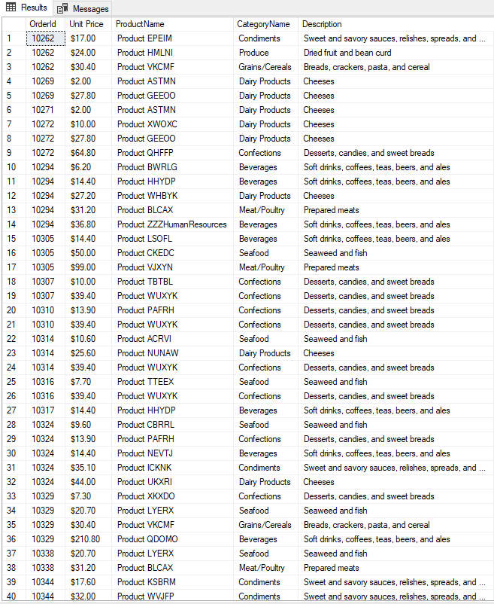
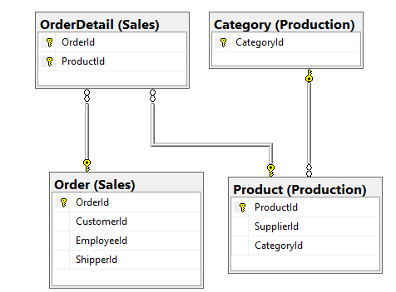
Muhammad Query 1 - good
Select every order and its category from a customer in the USA
show product description using custom function
from Northwinds2020TSQLV6;

Slide 13
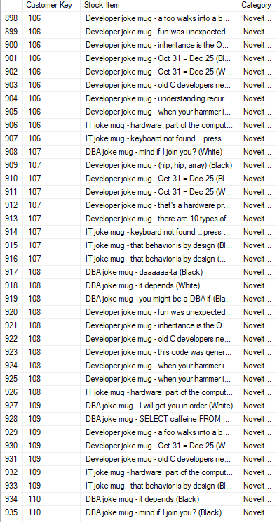
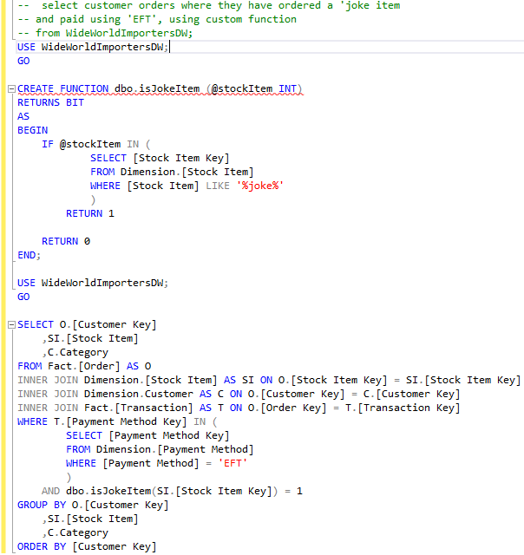
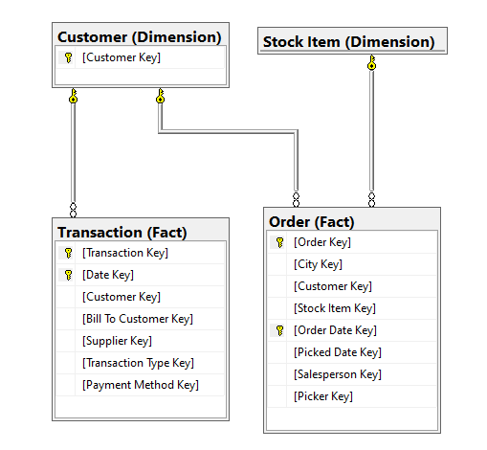
Muhammad Query 2 - good

Slide 14
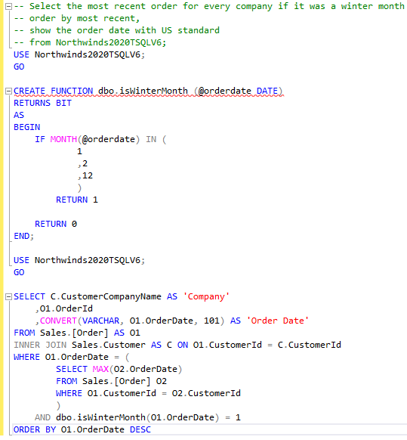
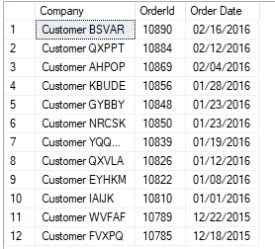
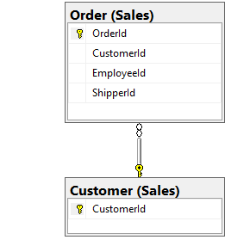
Muhammad Query 3 - good

Slide 15
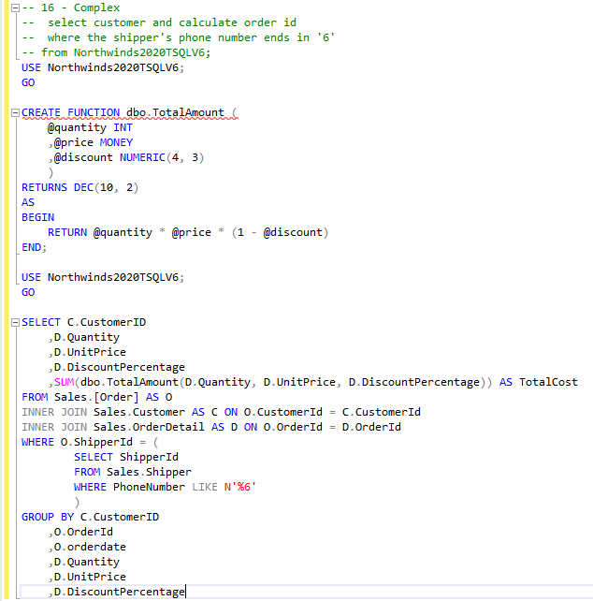
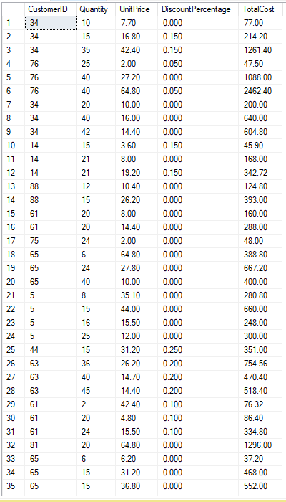
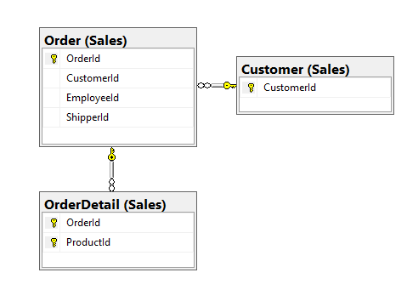
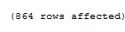
Muhammad Query 1 - not so good

Slide 16
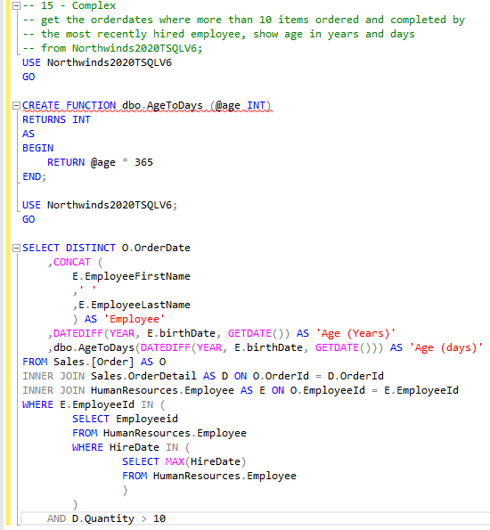
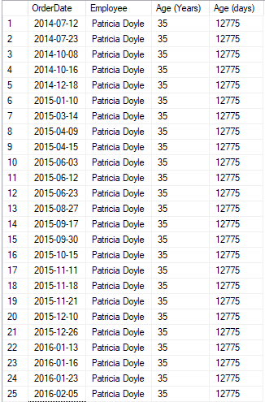
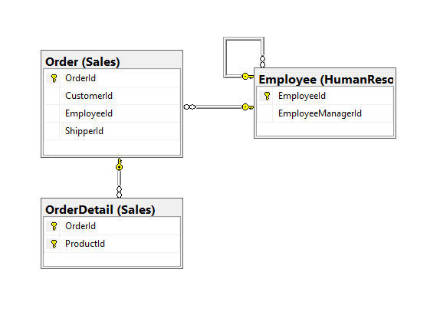
Muhammad Query 2 - not so good

Slide 17
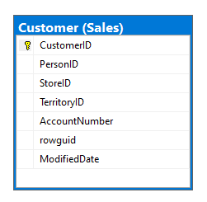
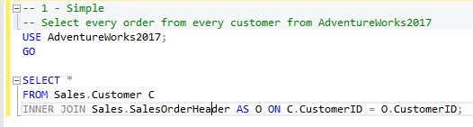
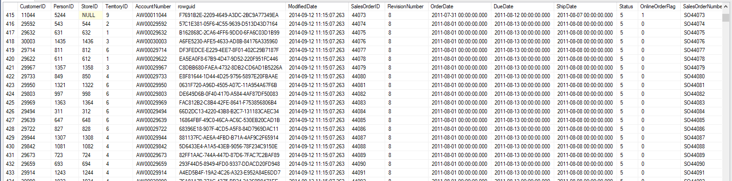
Muhammad Query 3 - not so good

Slide 18
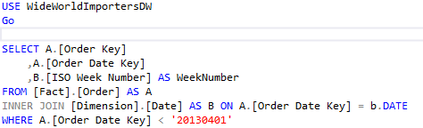
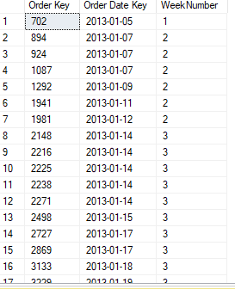
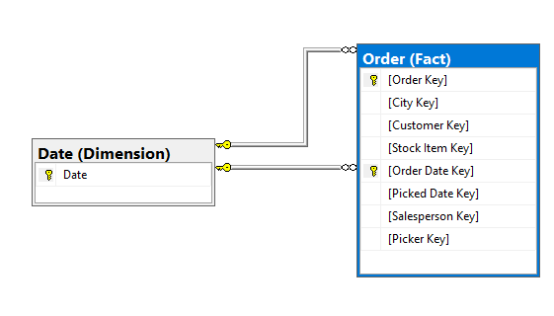
Andy
Get the week number for all orders that happened before april 2013

Slide 19
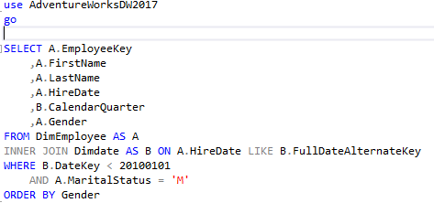
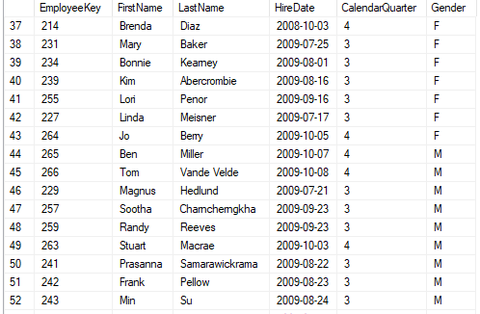
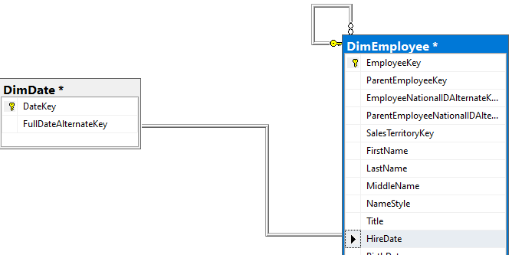
Get the employees that are hired before 2010 and the calendar quarter they were hired from that are married and order them by gender

Slide 20
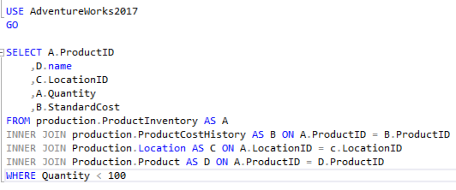
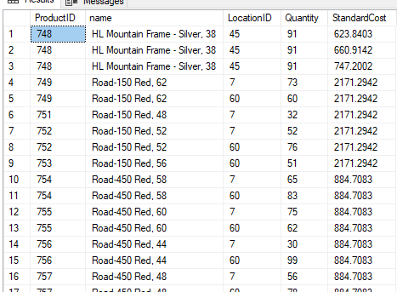
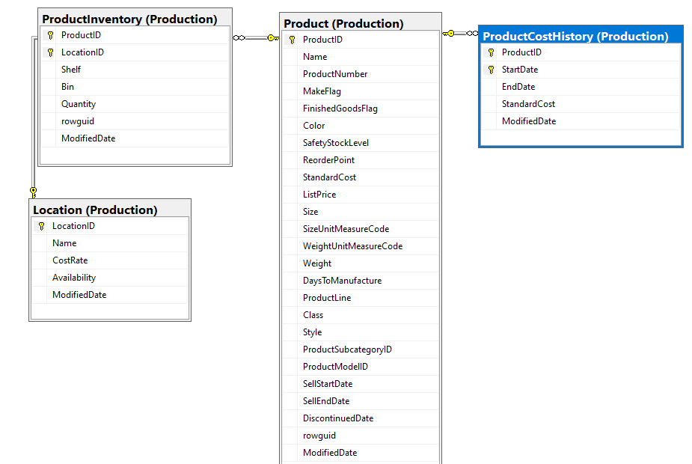
Get all the standard cost for all products that have less than 100 in quantity.

Slide 21
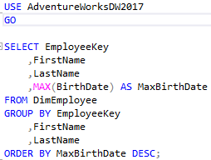
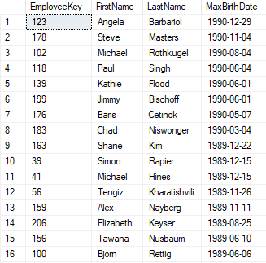
Gets the employees and orders all employee by day of birth

Slide 22
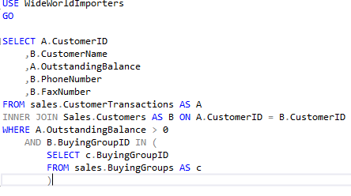
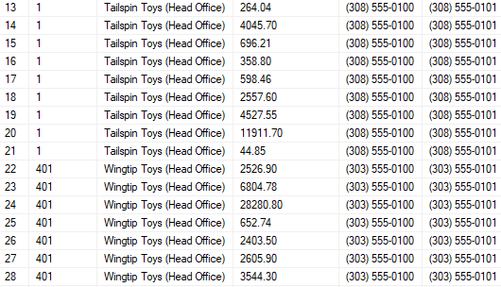
Get the name, phone and fax from all the orders with outstanding balance only from those that are in a buying group

Slide 23
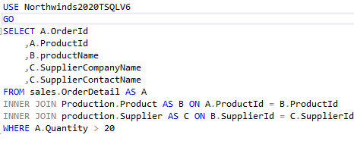
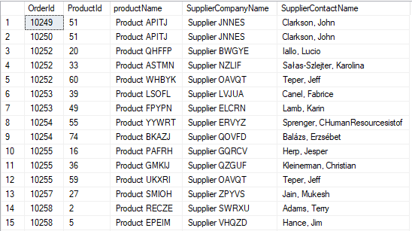
Get the supplier's information for those who order large amounts(over 20)

Slide 24


Jean
OUTPUT all customers Name, city, and postal code who country is Australia

Slide 25


This table will show the employee id and the number of times they have served customer 20 each year.

Slide 26



JEAN
Find how many develop joker mugs SalespersonId(2) has sold from the date of january to february of the year
2014 with the OrderId in ASC order

Slide 27



Find the names of the employees whose Job Title is “Marketing Specialist

Slide 28


Find the most recent order of each company name in ascending order

Slide 29




Selects all distinct customer ids and customer names in which salesperson number 3 helped pick out.

Slide 30



Sital (Query1)
Filter the order received by Jai Lamble from Invoices table whose order ID is equal to order ID in orders table and display orderdate, expected delivery date and confirmedreceived by.

Slide 31



Sital (Query2)
Joins table using CTEs and Inner join. It display the quantity, city key, delivery date key and maximum profit on ‘20140102’.

Slide 32



Sital (Query3)
It filters out the employee history with employee name, birthdate, maximum vacation hour they took while working, marital status, startdate and endate.

Slide 33


Sital(Query Corrected1)
This is a corrected queries. It joins two tables DimProduct and factResellerSales and filter out a spanish product name, english product name, reseller key, carrier tracking number, product standard cost and order quantity, in which product key is same for both tables.

Slide 34


Sital (Query Corrected 2)
It displays no. of received outer and ordered outer with maximum quantity and also display if the order is finalized using a subquery.

Slide 35


Sital (Query Corrected 3)
It shows the total number of orders shipped to France and group by customerId, Orderdate and shipToCountry.

Slide 36


Chao1

Slide 37


Chao 2

Slide 38


Chao 3

Slide 39


Chao 4

Slide 40


Chao 5

Slide 41


Chao 6

Slide 42


Worst Queries - Corrected
Gets the employees and orders all employee by day of birth
Every employee that has a common first name a customer

Slide 43


Worst Queries - Corrected
Added where clause to return only those with a quantity greater than or equal to 5. Also removed primary contact and added the sale key and tax amount.

Slide 44


Worst Queries - Corrected
Query was too simple and not useful, produced too many rows.
New updated query to show customerid and no of orders placed with items that are discontinued. Also switched to Northwinds DB.

Slide 45


